Slide 1
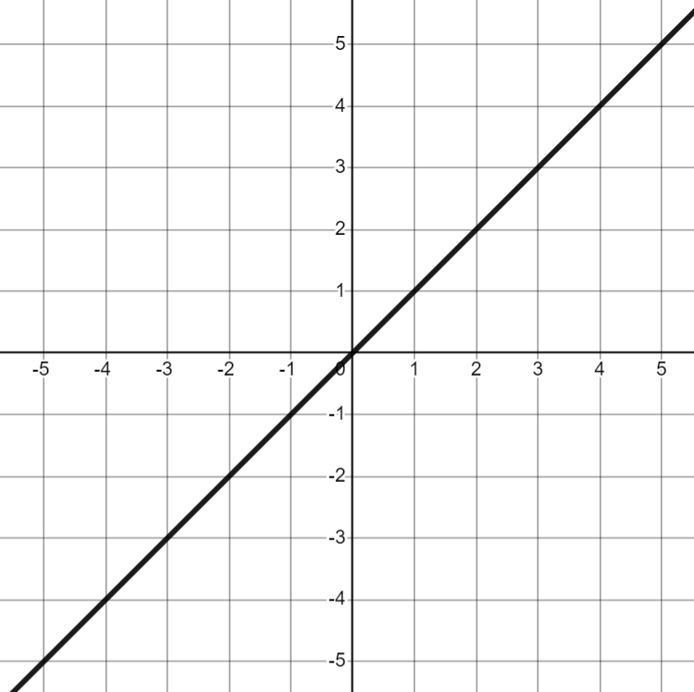
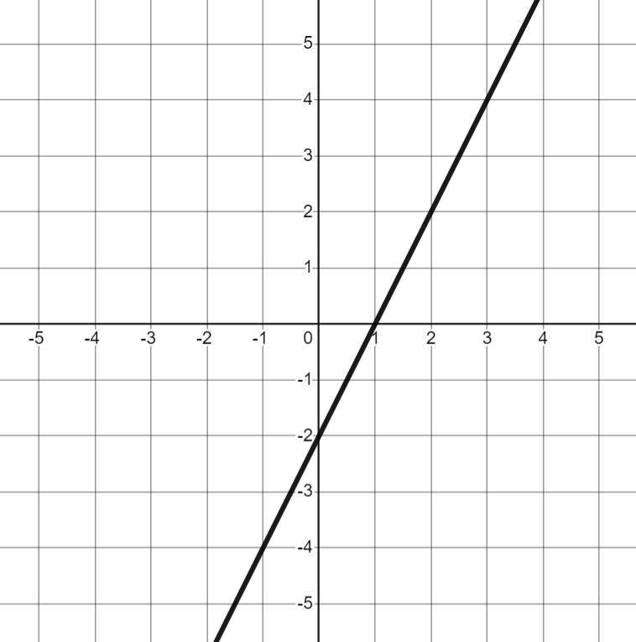
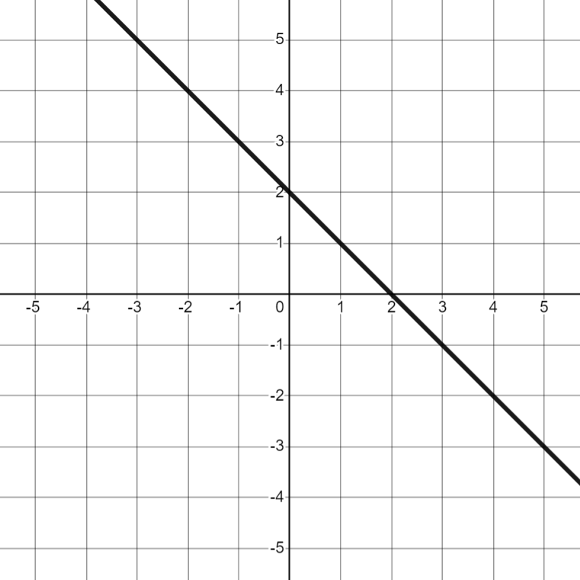
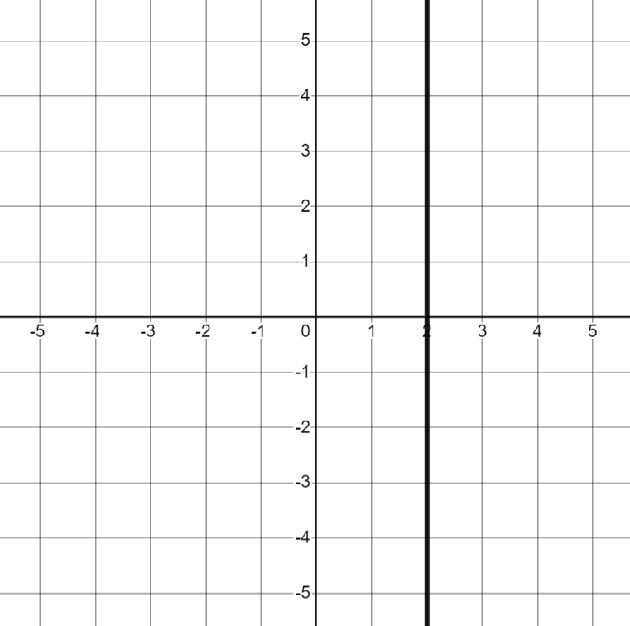
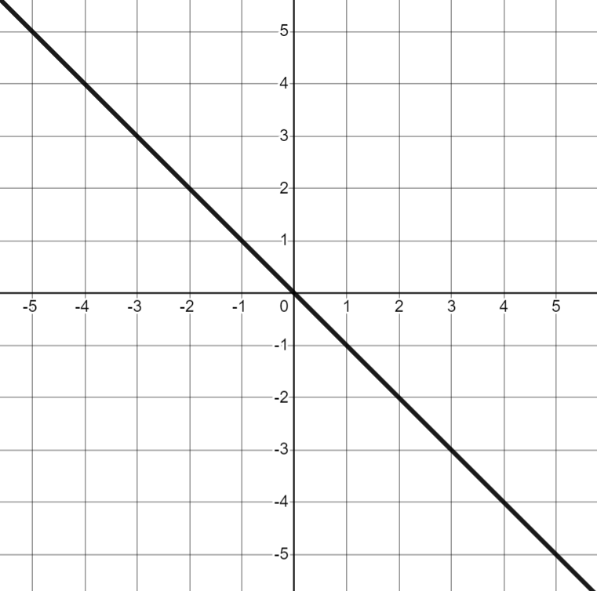
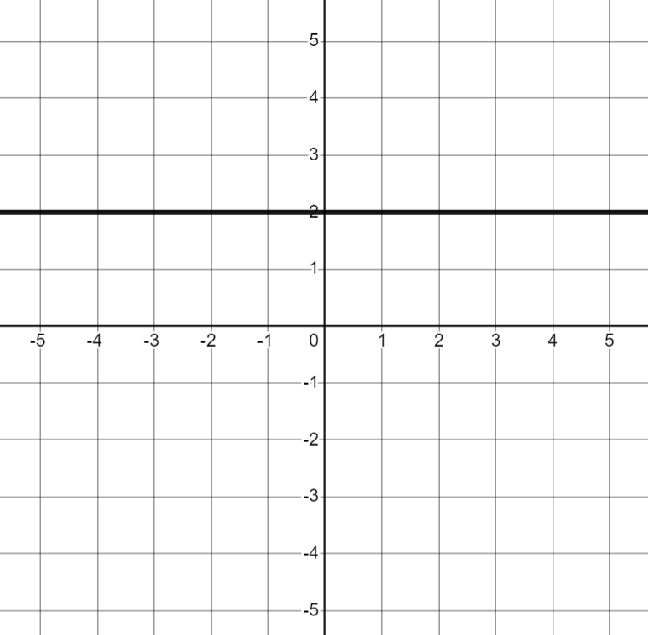
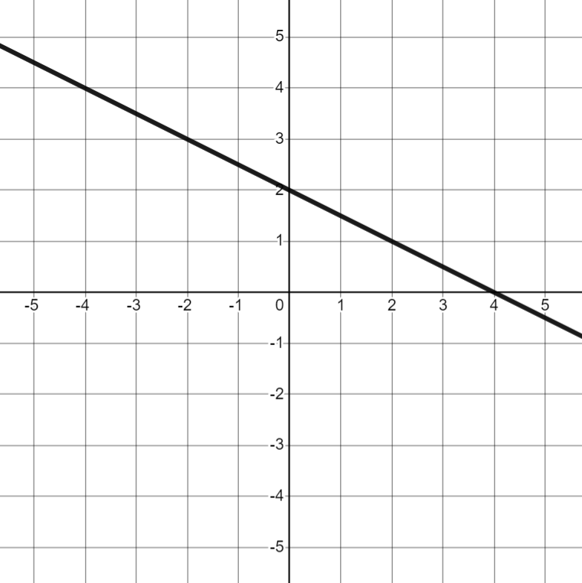
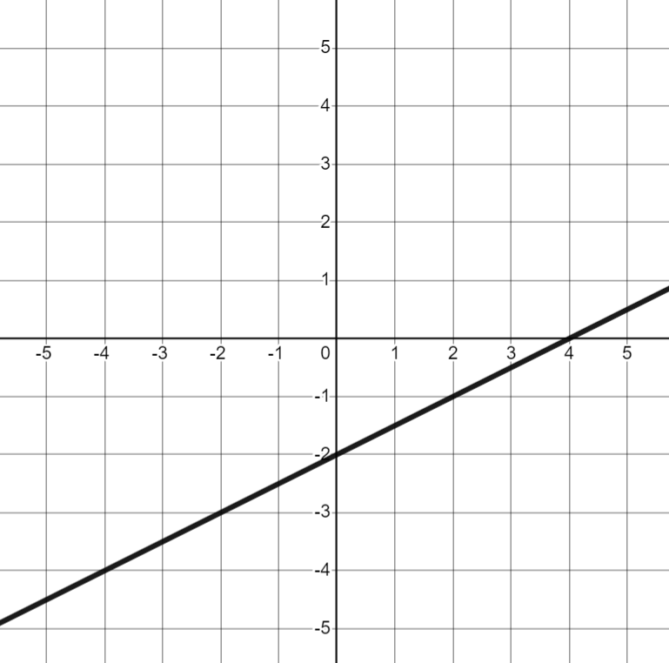
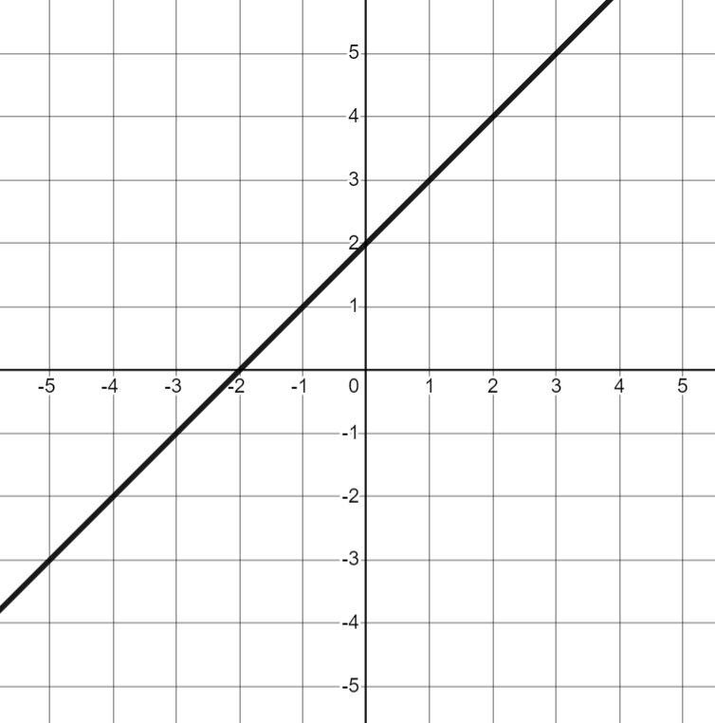
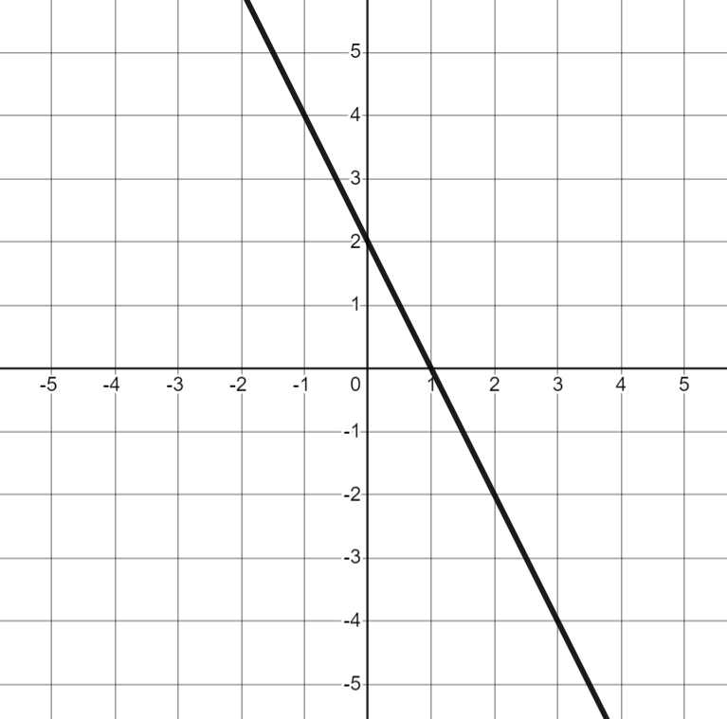

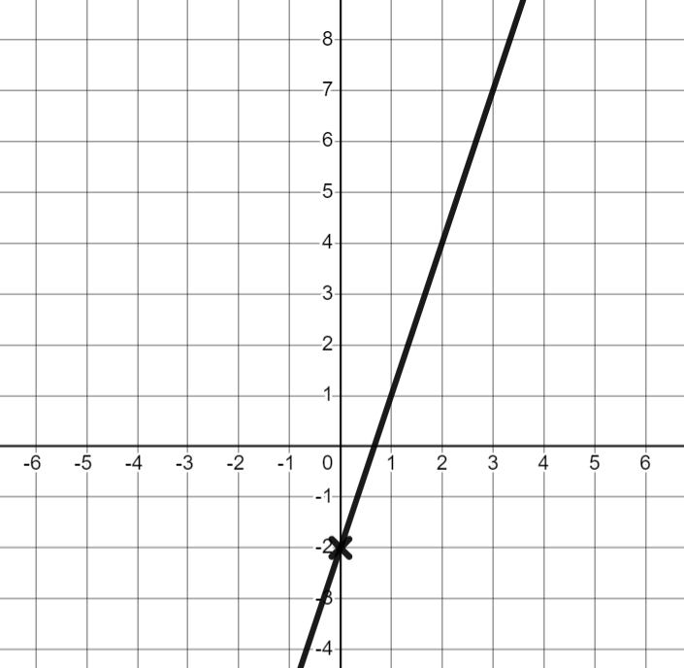
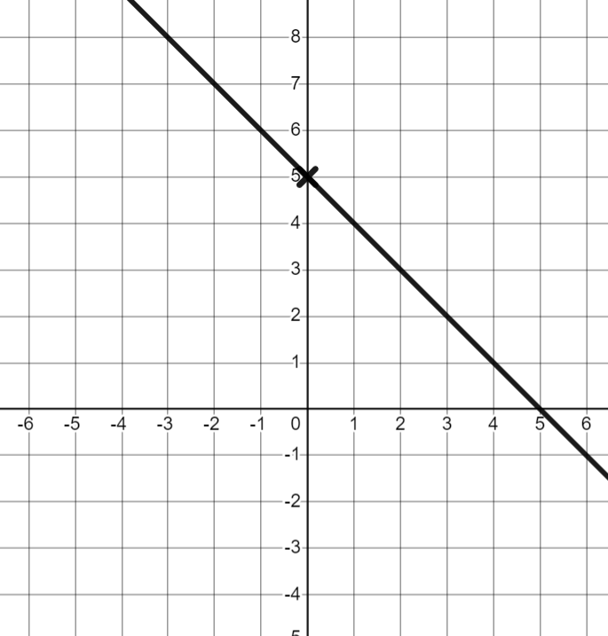
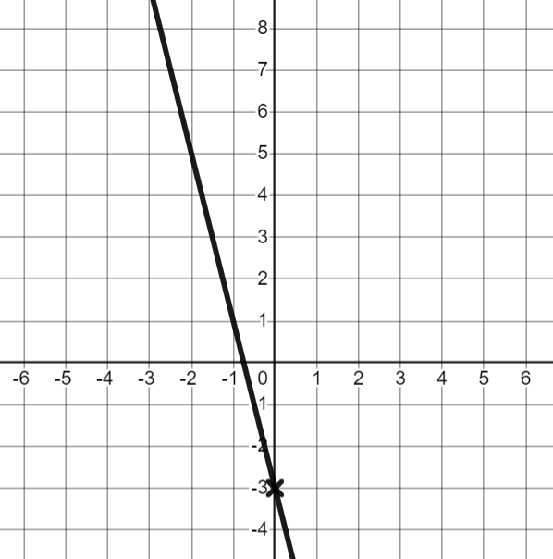
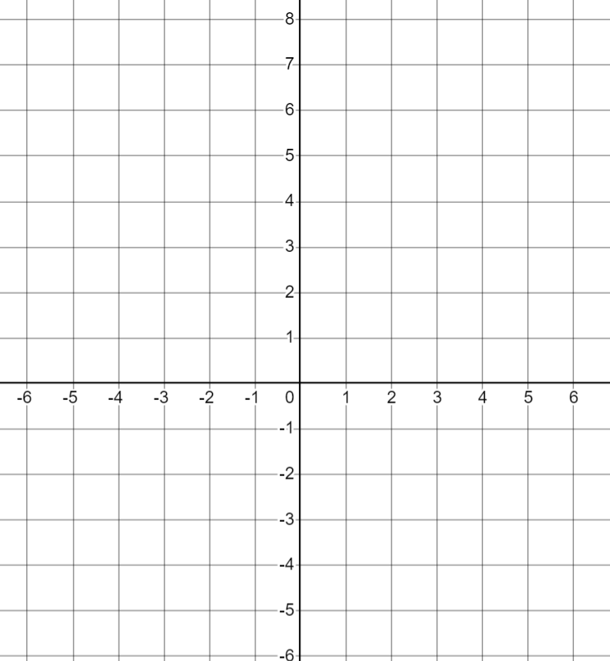
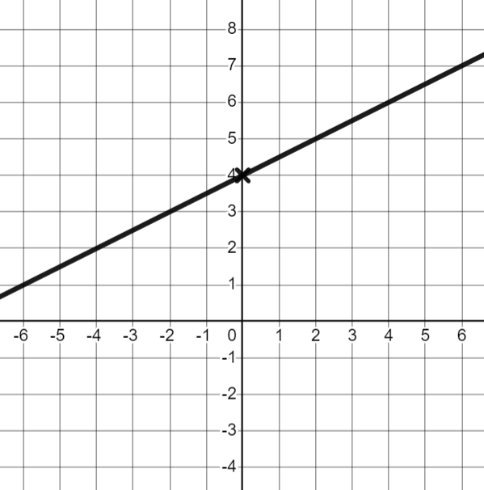
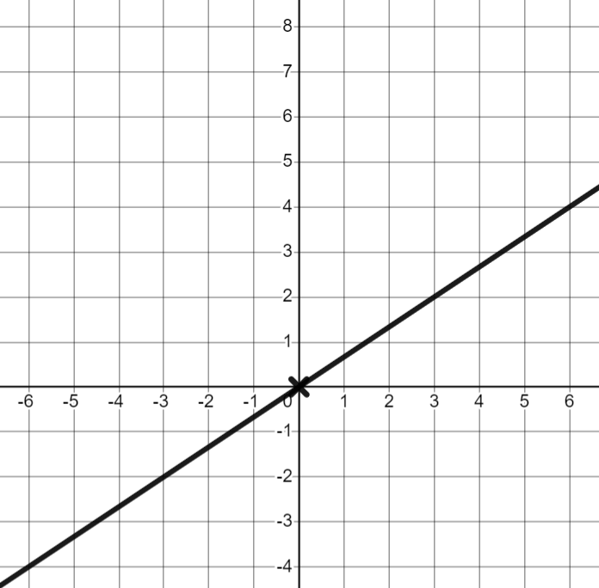
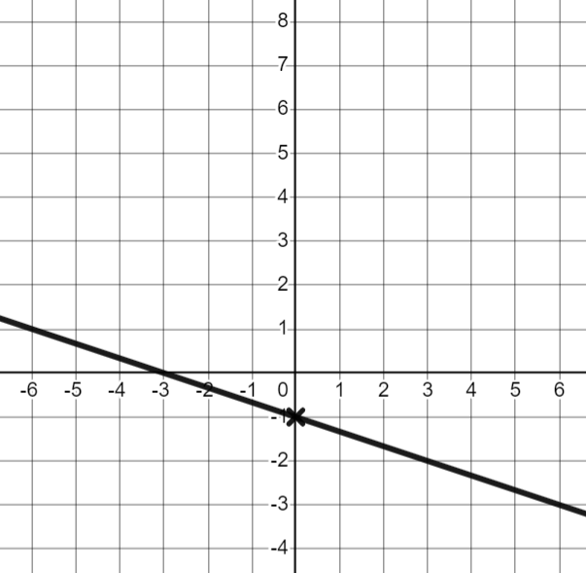


Finding the equation of the line ay + bx + c = 0
Task A: Equations in the form y = mx + c
1) Match each graph to its equation
a) | b) | c) | d) | e)
y = x
y = 2x − 2
y = 2 − x
x = 2
y = −x
f) | g) | h) | i) | j)
y = 2
y = 2 − x
y = x − 2
y = x + 2
y = 2 − 2x
2) For each question, work out an equation for the line and use the key features to draw the line on the axes.
 | b) | c)
gradient: 3
y-intercept: (0, −2)
equation: y = 3x − 2
gradient: −1
y-intercept: (0, 5)
equation: y = −x + 5
gradient: −4
y-intercept: (0, −3)
equation: y = −4x − 3
d) | e) | f)
gradient:
y-intercept: (0,4)
equation: y = x + 4
gradient:
y-intercept: (0, −1)
equation: y = x − 1
gradient:
y-intercept: (0, 0)
equation: y = x

Slide 2
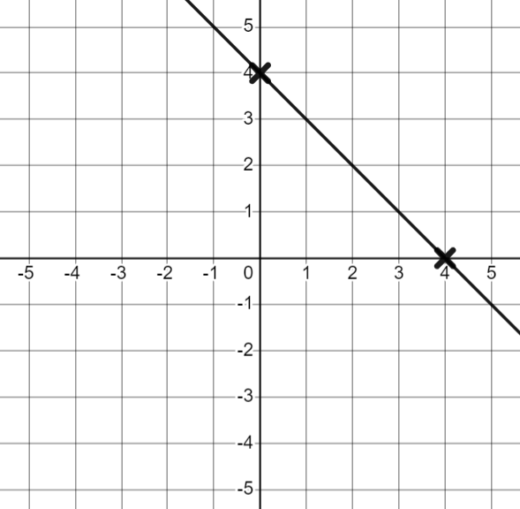
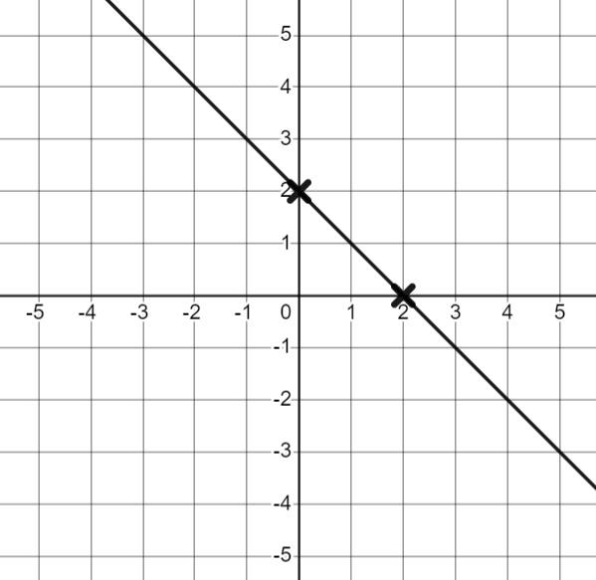
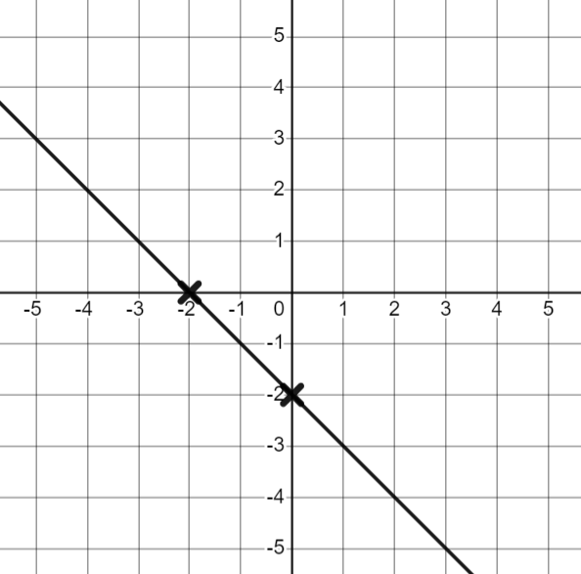
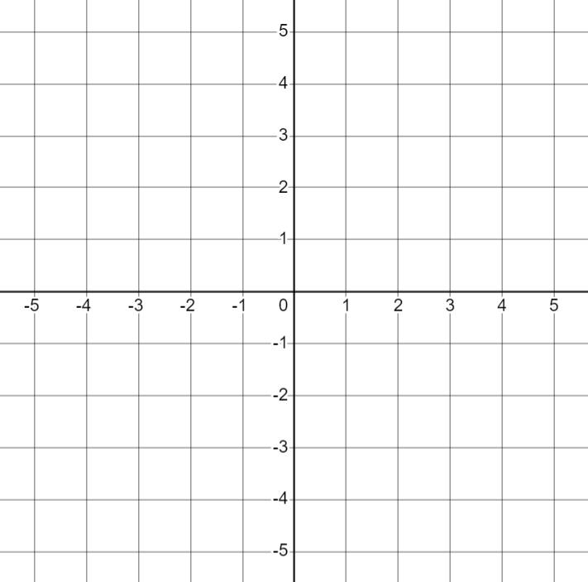
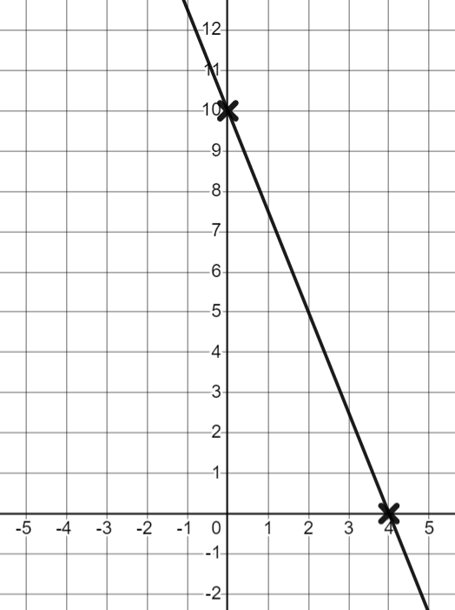
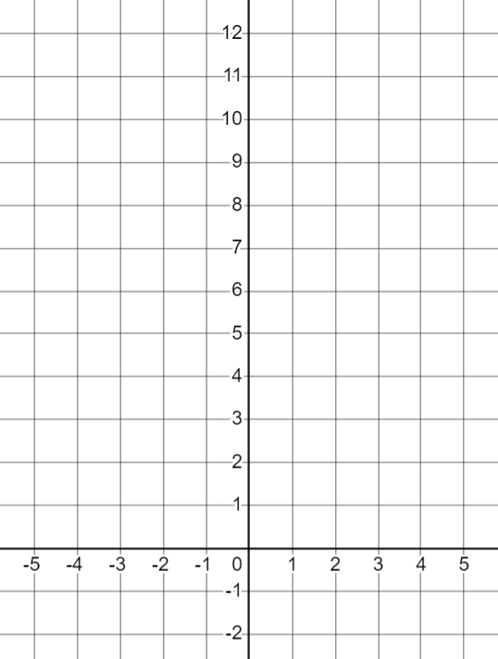
Finding the equation of the line ay + bx + c = 0
Task B: Equations in the form ay + bx + c = 0
1) For each equation, work out the y-intercept, the x-intercept and draw the graph.
a) y + x − 4 = 0 | b) y + x − 2 = 0 | c) y + x + 2 = 0
y-intercept (0,4)
y-intercept (0,2)
y-intercept (0,−2)
x-intercept (4,0)
x-intercept (2,0)
x-intercept (−2,0)
2) From the bar model, write the relationship as as an equation in the form y = mx + c and ax + by + c = 0
a)
y
2
b)
10
x
x
x
y
x
x
y = mx + c : y = 3x − 2
ax + by + c = 0 : 3x − y − 2 = 0
y = mx + c : y = 10 − 2x
ax + by + c = 0 : 2x + y − 10 = 0
3) Fill in the missing working, then draw the graph of 2y + 5x − 20 = 0
y-intercept
2y + 5(0) − 20 = 0
2y − 20 = 0
2y = 20
y = 10 (0,10)
x-intercept
2(0) + 5x − 20 = 0
5x − 20 = 0
5x = 20
x = 4 (4, 0)
Mathematics in Education and Industry
v2.2

